Slide 1

Automatic Speech Recognition
Paper talk

Slide 2
Outlines
Brief Introduction
Rough History
Paper Talk
Wave2vec 2.0
HuBERT
HuBERT EE
Pushing the limits of semi supervised learning
Notes:
First of all, I will give a brief introduction of the speech recognition system,
Then I will discuss a rough history of SR system explained in some review papers
Later on, I will try to elaborate SOTA, finding and results of the following papers one by one
I would definitely seek your guidance, wherever I got stuck

Slide 3
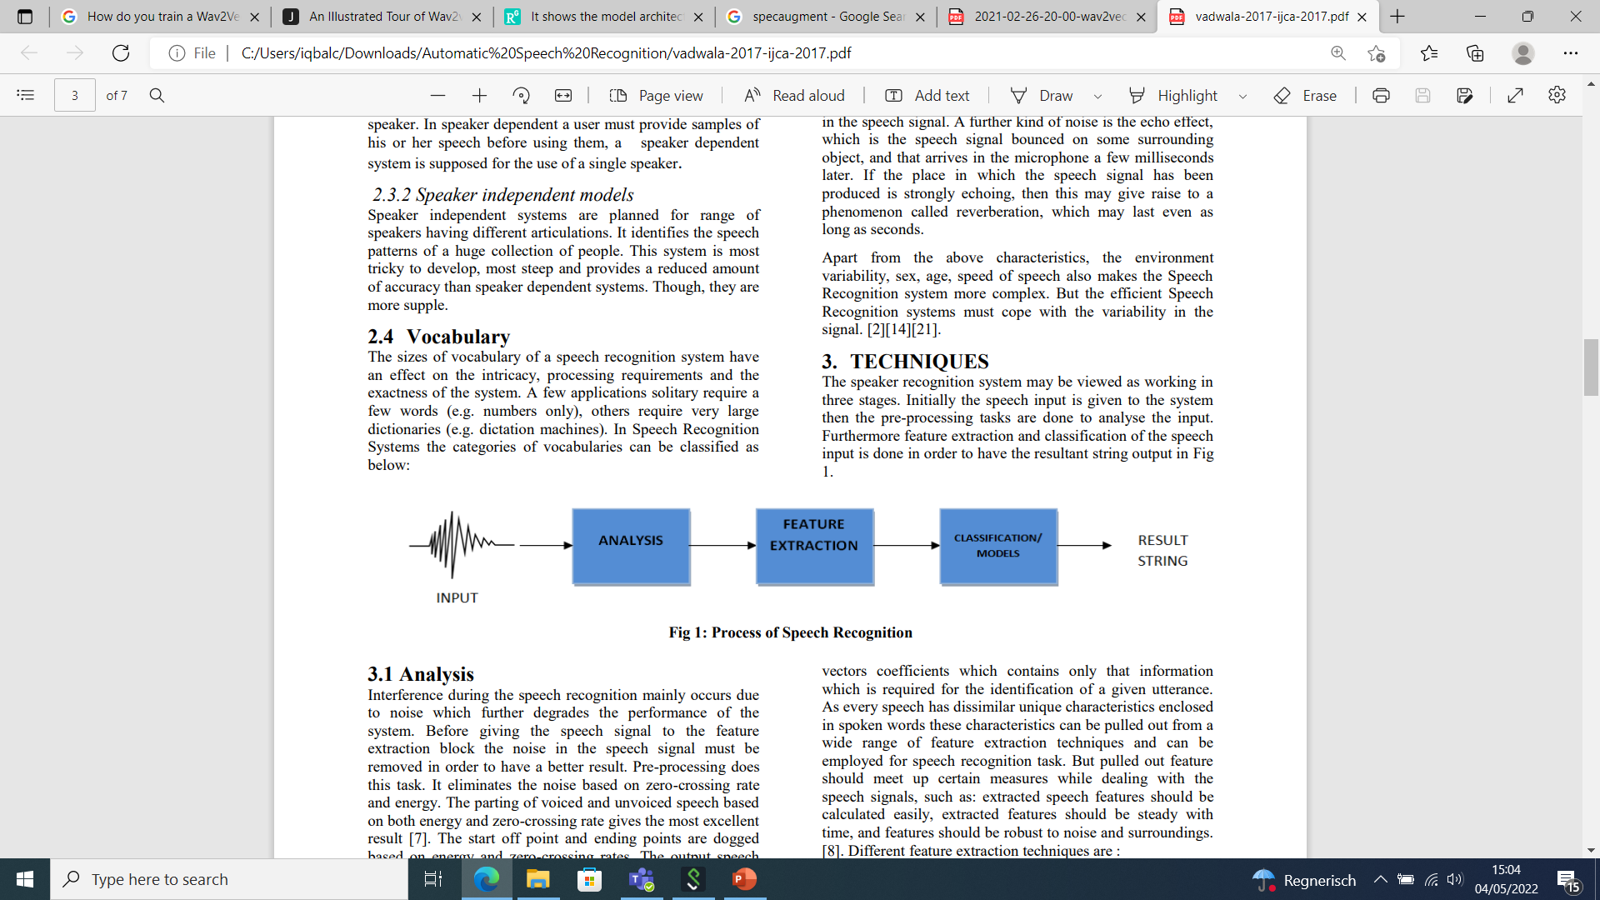
Automatic Speech Recognition (ASR) (vadwala et. al., 2017)
An ideal ASR should be able to “perceive” the given input of sound waves
and covert into text format
The recognized words as an input to another machine can perform some
“action” in a result.
Notes:
Speech recognition is the process of analyzing audio signals to identify the words
Noise Degrade the performance, at the preprocessing stage noise is removed
Feature extraction important stage, Transform the signal into stream of feature vectors, contain information

Slide 4
Ideal features for Speech Recognition
Global Vocabulary
Speech Recognition Automatically (such as voice search, speech transcription, etc)
Noise Robustness
Automatic Punctuation
Notes:
To recognize more languages with an extensive vocabulary
System should handle the noise in the environment
We do not pronounce the punctuation but for ideal ASR system, we expect to see the proper punctuation for the text like capitalization, comma pause.

Slide 5
Automatic Speech Recognition Problems
Spontaneous vs Read Speech
Large Vocabulary
Noise
Low Resource
Far field
Speaker adaptive
Notes:
Speaker adaptive require small amount of speaker specific training data

Slide 6
Speech Representation
Speech:
It is the waves changing air pressure produced through the excitation from vocal cords
Modulated the sound by vocal tract by moving/shaping of mouth (tongue, teeth, lips)
Analogue audio signals are converted to digital through microphone
Sound Frequency
Human Hearing Frequency Range: 20HZ to 20KHZ (approx.)
Human Speech: 85 HZ to 8KHZ (approx.)
Speech processing mostly around 16 KHZ 16bits/sample
Notes:
Now, I will quickly highlight the points regarding speech and frequency of sound

Slide 7
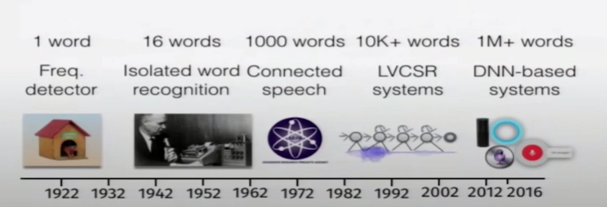
Rough History of ASR
1960s Dynamic Time Warping
1970s Hidden Markov Models
Multi-layer perceptron 1986
Speech recognition with neural networks 1987-1995
Superseded by GMMs 1995-2009
Neural network features 2002
Deep networks 2006 (Hinton. 2002)
Deep networks for speech recognition
- Good results on TIMIT (Mohamed et al., 2009)
- Results on large vocabulary systems 2010 (Dahl et al., 2011)
- Google launches DNN ASR product 2011
- Dominant paradigm for ASR 2012 (Hinton et al. 2012)
Recurrent Neural networks for speech recognition 2012-
- New models (attention, Listen attendance spell, neural transducer)
Radio Rex ShoeBox HARPY
Notes:
Radio Rex, bell lab developed speech synthesis machine but it was discarded due to incorrect conculsion
DTW- is stretching template to match speech signals…record voice---frequency representations—find distance measure and ty to find the best fit.
Gaussian mixtures model took dominant time about 10 to 15 years,, they outperformed with NN

Slide 8
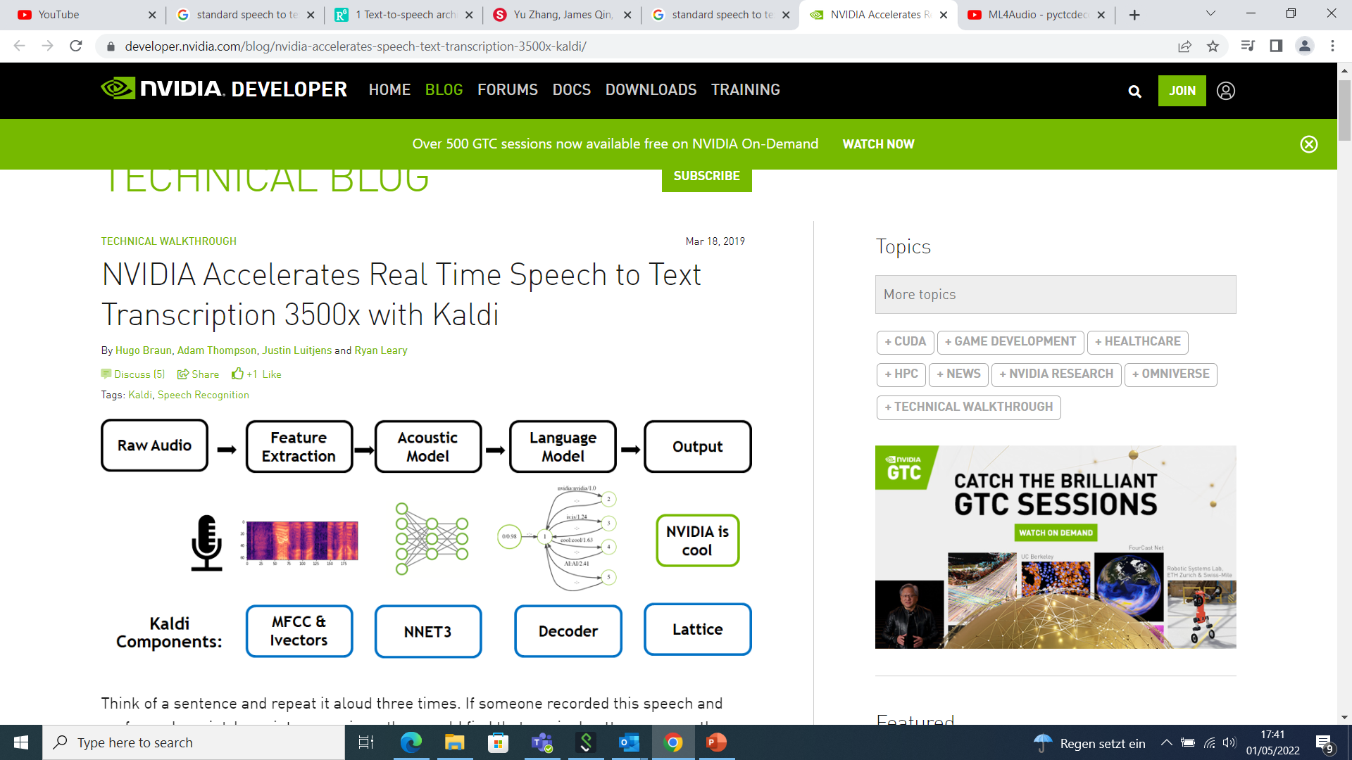
Modules of ASR
Start with an audio sample
Perform Pre-processing to get Features for every n/millisecond chunk of audio
Pass the generated features through a neural network model
Wave2vec, citrinet
And finally we analyze that through logit matrix that represents the probabilities
Pass that to the Language model or decoder and return the actual text that is human readable.
Notes:
Feature extraction requires much attention bcz performance relies heavily.
Acoustic model is main component, developed for detecting the spoken phoneme
combinations of phonemes are defined through lexicon model to give valid words
Lexical model to provide pronunciation of each word and LM consisting of millions of parameters and with the help of pronunciation dictionary
And used to search for correct word sequence by predicting

Slide 9
Feature extraction techniques (Vadwala et al., 2017)
Different feature extraction techniques that has been used are as following:
1. Mel-Frequency Cepstrum Coefficients (MFCC)
2. Linear Predictive Coding (LPC)
3. Linear Prediction Cepstral Coefficients (LPCC)
4. Perceptual Linear Prediction (PLP)
5. Linear Discriminant Analysis (LDA)
6. Discrete Wavelet Transform (DWT)
7. Relative Spectral (RASTA-PLP)
8. Principal Component analysis (PCA)

Slide 10
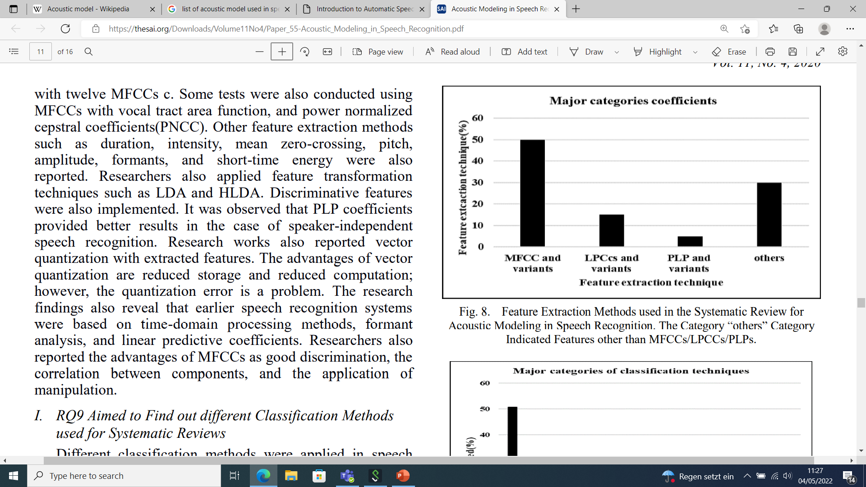
Feature Extraction techniques in Systematic Review (Shohba et al.,2020)

Slide 11
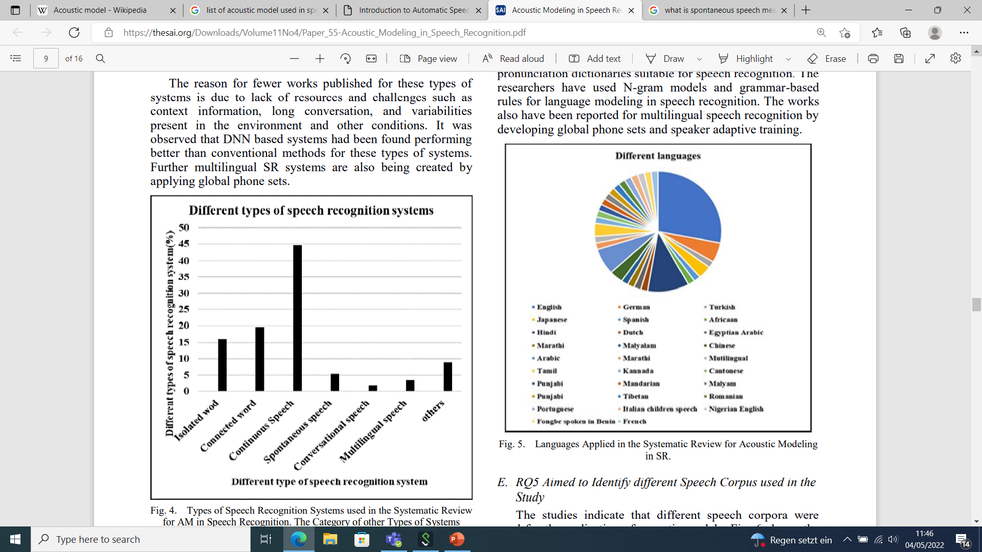
Types of SR Systems (Shohba et al.,2020)
The research findings indicate
Significant research work has presented for continuous speech and connected words due to their more applications.
A limited work has been reported towards spontaneous speech, conversational speech, and multilingual speech.

Slide 12
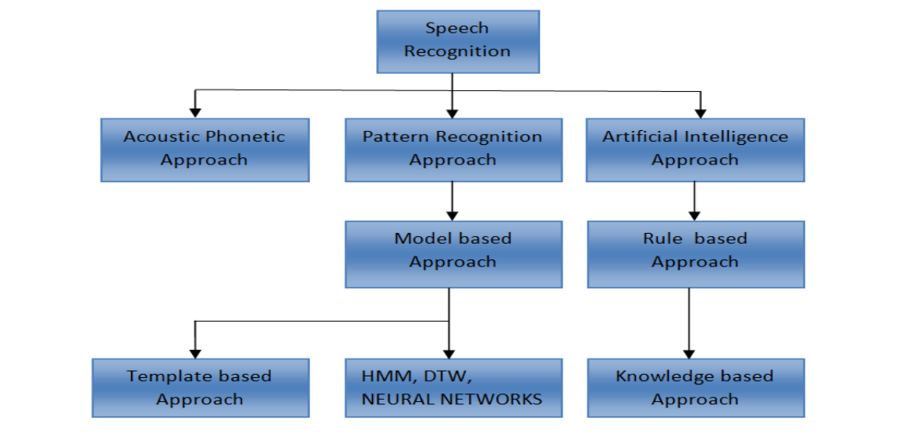
Classification of Speech Recognition

Slide 13
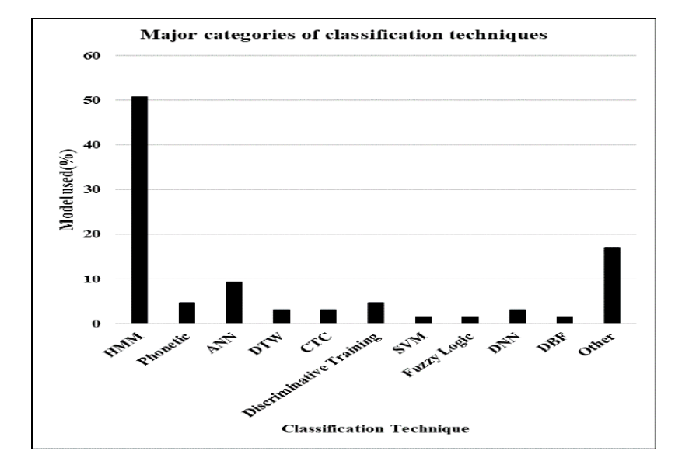
Classification Techniques for SR Systems (Shohba et al.,2020)
Research findings reveal that
HMM-based systems were widely used during the past decades
However, In recent years, Hybrid models are being used
- HMM-DNN
- HMM-GMM
- End to end Models
Notes:
to develop acoustic models

Slide 14
Neural Network Architecture for Speech Recognition
Fully connected (DNNs)
Convolutional Networks (CNNs)
Recurrent Neural Networks (RNNs)
LSTMs
GRUs
Nowadays, long-short term memory (LSTM), a type of recurrent neural network (RNN), is being used for speech recognition in combination with different deep learning techniques
Notes:
RNNs are good for processing sequential data such as NLP tasks and audio recognition

Slide 15
Evaluation techniques for ASR (Malik et at., 2021)
The performance of a speech recognition system usually depends on two factors:
The Accuracy of the output produced
The processing Speed of the ASR
Word Error Rate (WER) and Word Recognition Rate (WRR) is used to find the accuracy of system
The Real-time factor (RTF) is the most commonly used metric for calculating the speed of a proposed model

Slide 16
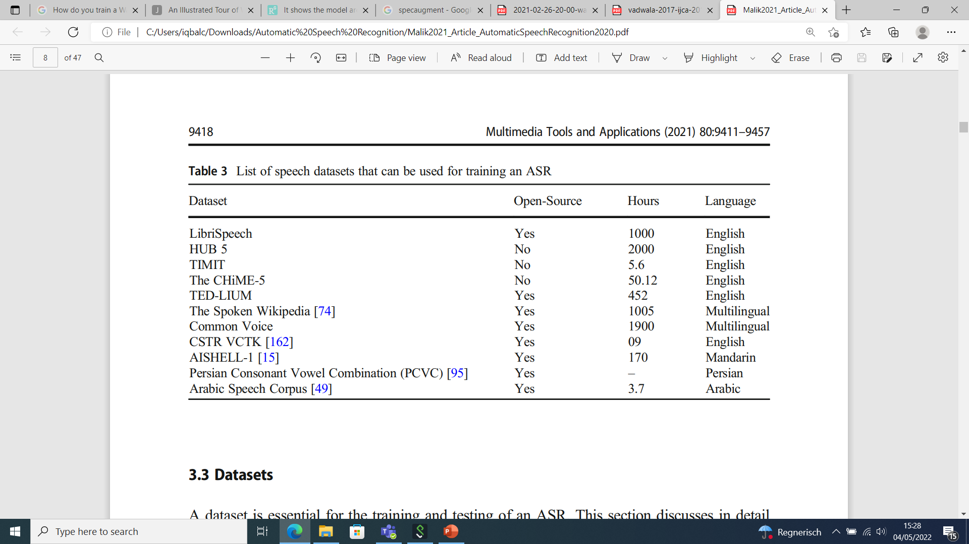
List of datasets that can be used for training ASR (Malik et at., 2021)
Notes:
LibriSpeech is one of the most frequently used speech-to-text corpus. This dataset consists of 1000 h of audiobooks along with their transcriptions.
Because of the large magnitude, it is divided into three sets. 100 h, 360 h ,500 h of training data.

Slide 17
SOTA models require thousands of hours of transcribed speech
So many data are not available for the vast majority of the nearly 7,000 languages
For noncommercial companies its almost impossible to obtain such an amount of data

Slide 18
wav2vec 2.0: A Framework for Self-Supervised Learning of Speech Representations by Alexei Baevski, Henry Zhou, Abdelrahman Mohamed, Michael Auli
Notes:
Wave2vec has brought significant importance in ASR. It is trained on large amount of unlabeled audio data with quantization module. The resulting representations are used to improve the acoustic model

Slide 19
Introduction
Self supervised Learning is used to learn powerful representations from speech audio
wav2vec 2.0 masks the speech input in the latent space and solves a contrastive task defined over a quantization of the latent representations which are jointly learned.
State of the art on both the 100 hours subset of LibriSpeech and TIMIT
Using just 10 minutes of labeled data and pre-training on 53k hours of unlabeled data still achieves 4.8/8.2 WER
Notes:
The main goal of the proposed model is to learn powerful representations from speech audio to create pretrained architecture that can be fine tuned for speech recognition

Slide 20
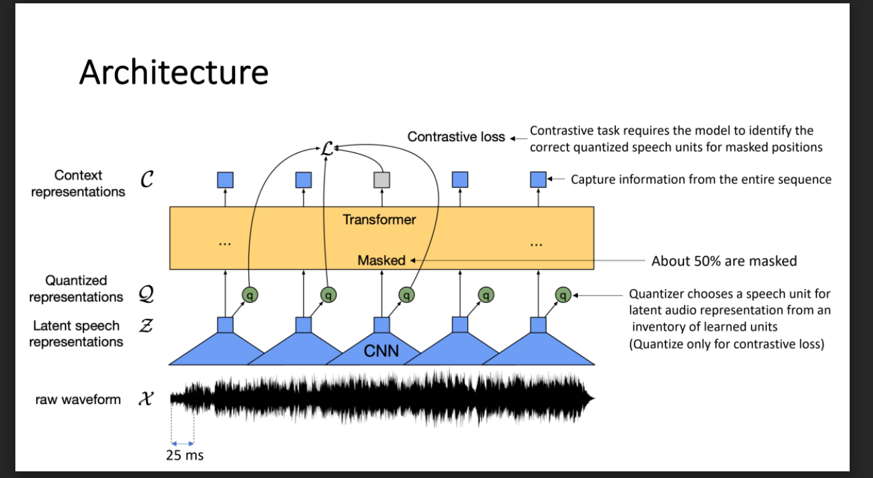
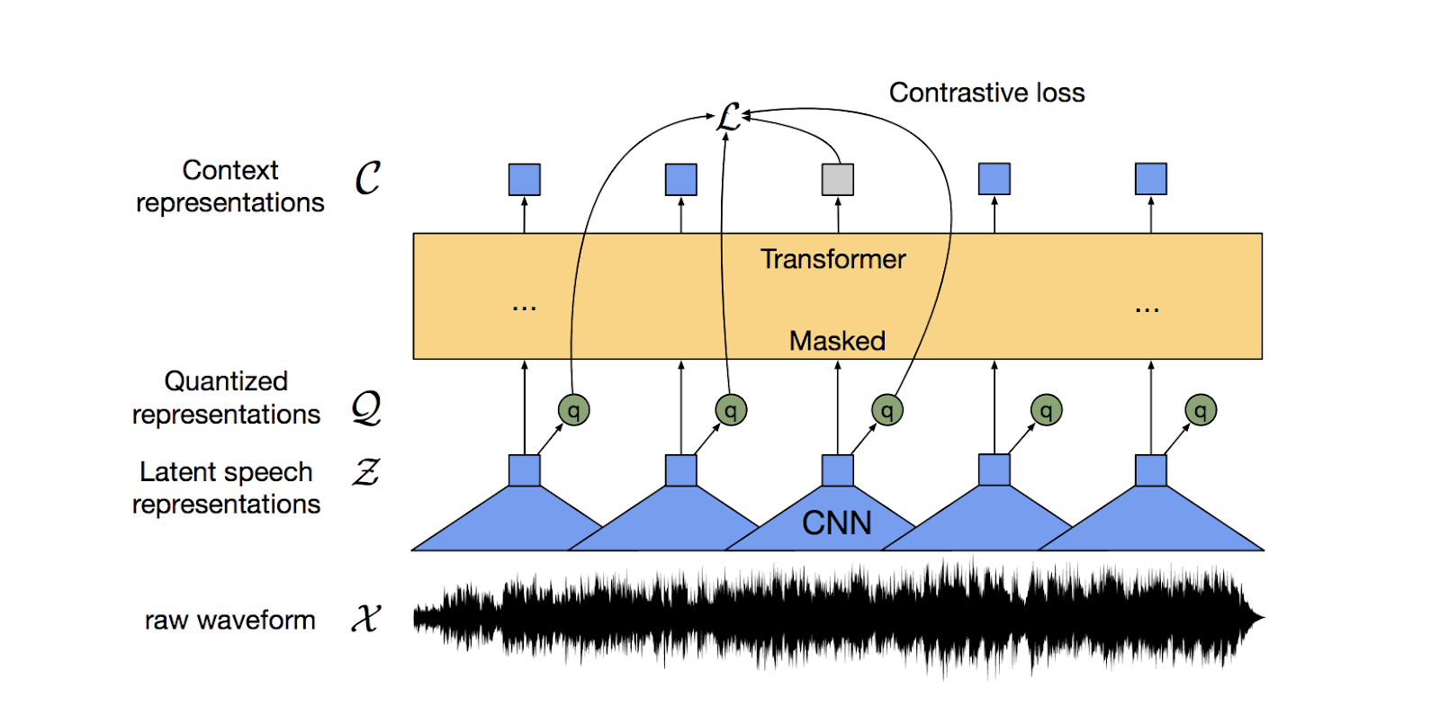
2.1 Model architecture
Notes:
Architecture based on transformer encoder
Training objective is similar to BERT masked language modelling
audio is passed via a multi-layer convolutional neural network and then masks spans of the resulting latent speech representations. The latent representations are fed to a Transformer network to build contextualized representations and the model is trained via a contrastive task where the true latent is to be distinguished from distractors.

Slide 21
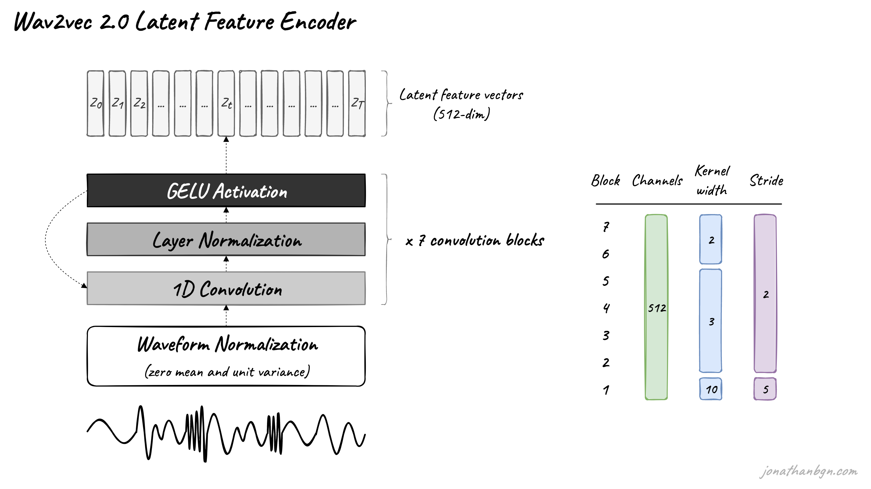
Notes:
It is to reduce the dimensionality of the audio data, converting the raw waveform into a sequence of feature vectors Z₀, Z₁, Z₂, …, Z_{T} each 20 milliseconds.
Gaussian Error Linear Unit activation function

Slide 22
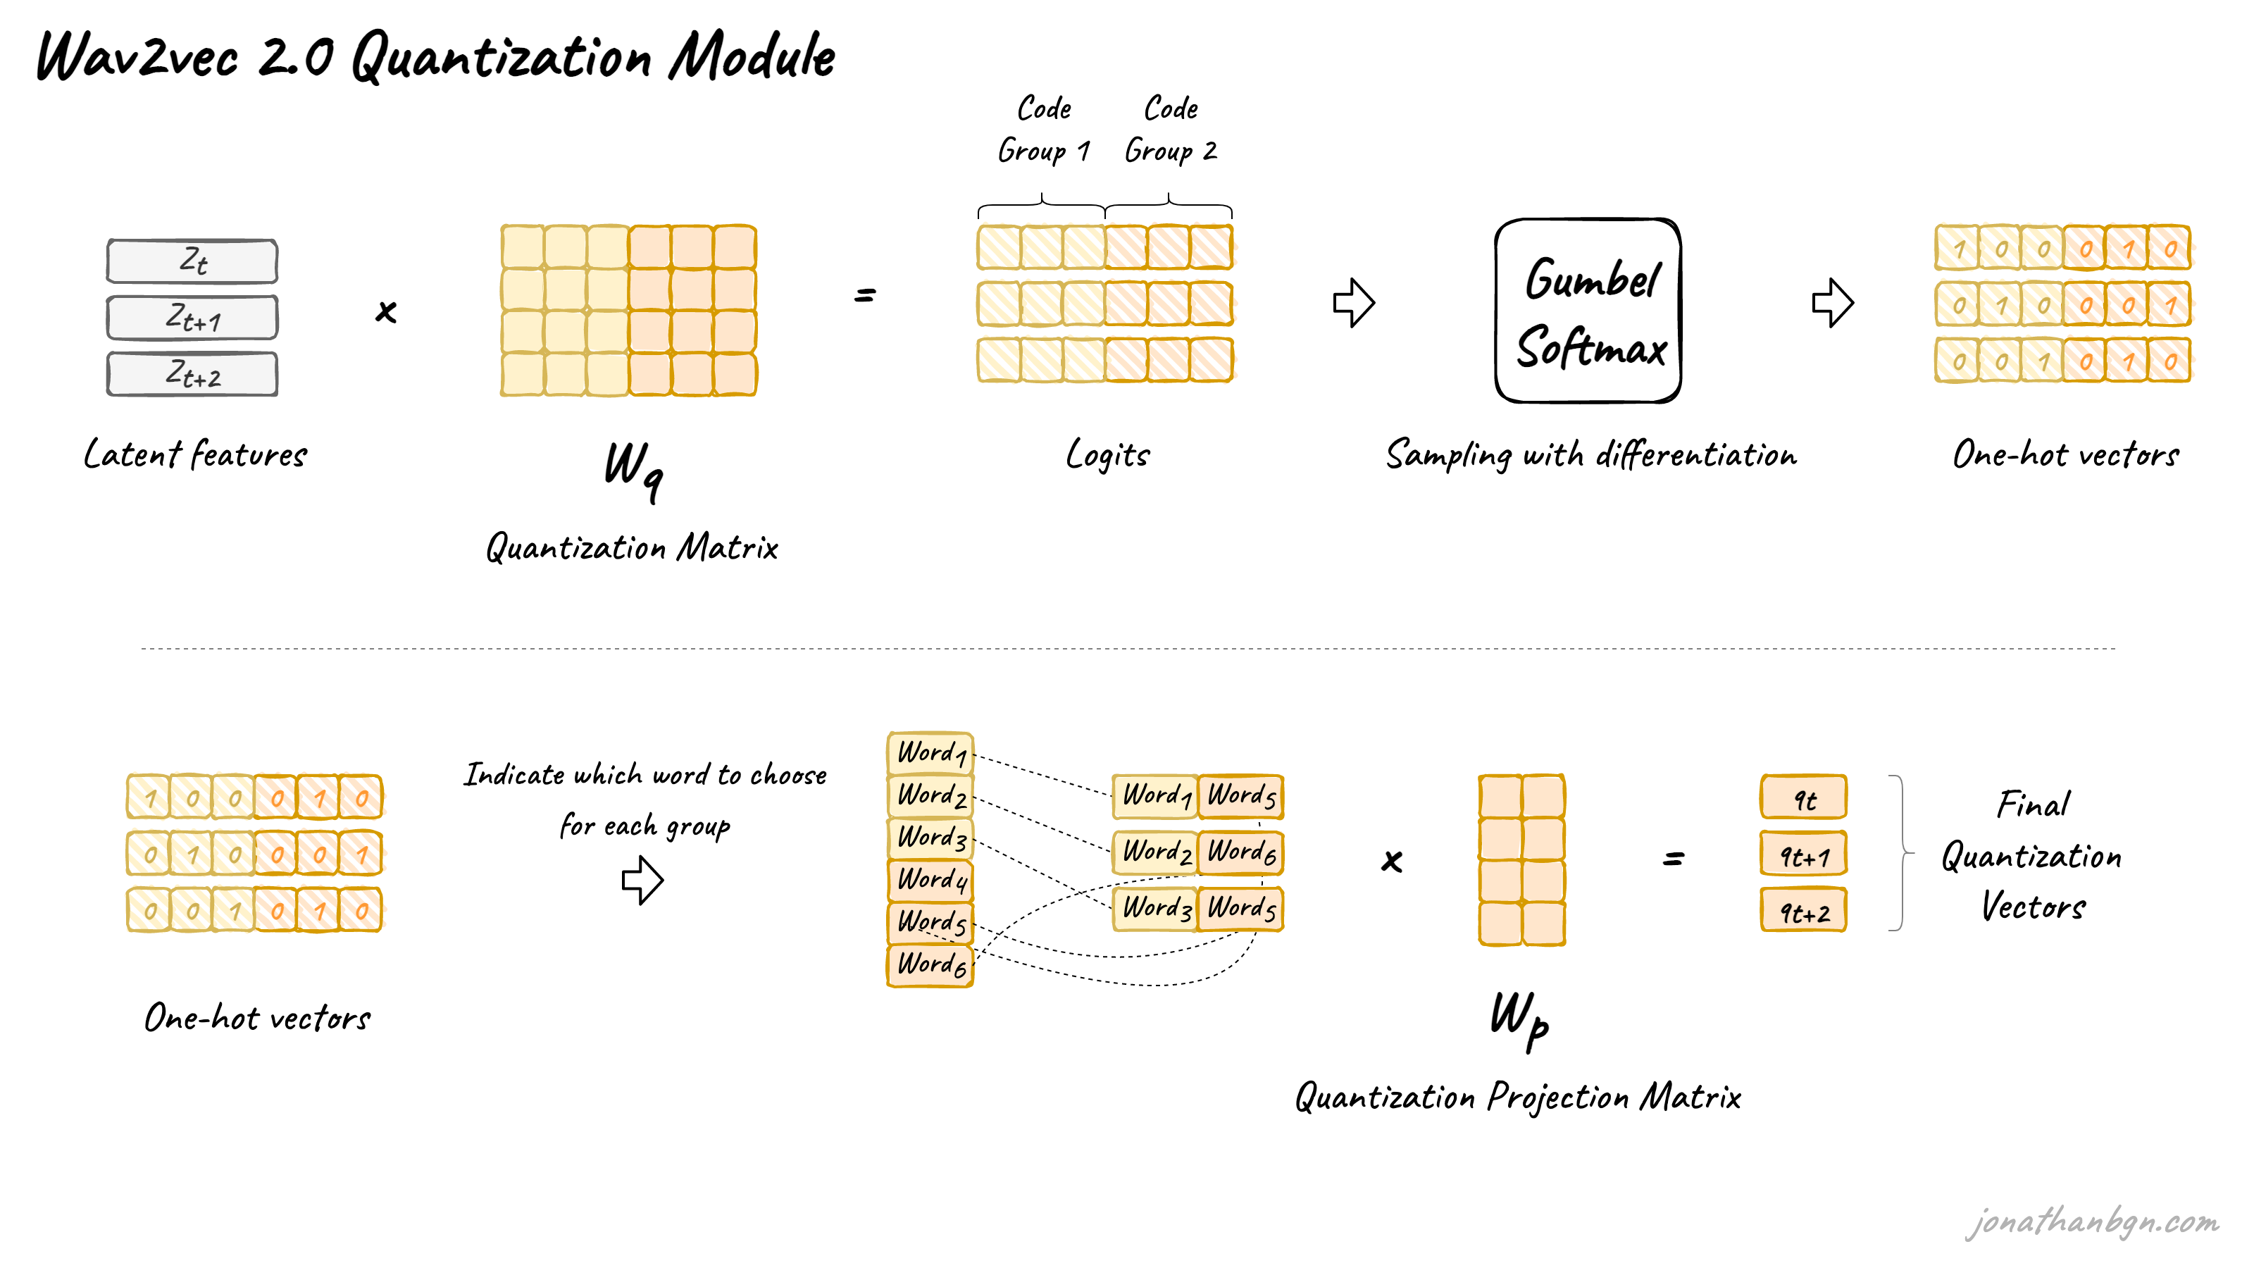
Quantization module
We discretize the output of the feature encoder z to a finite set of speech representations via product quantization

Slide 23
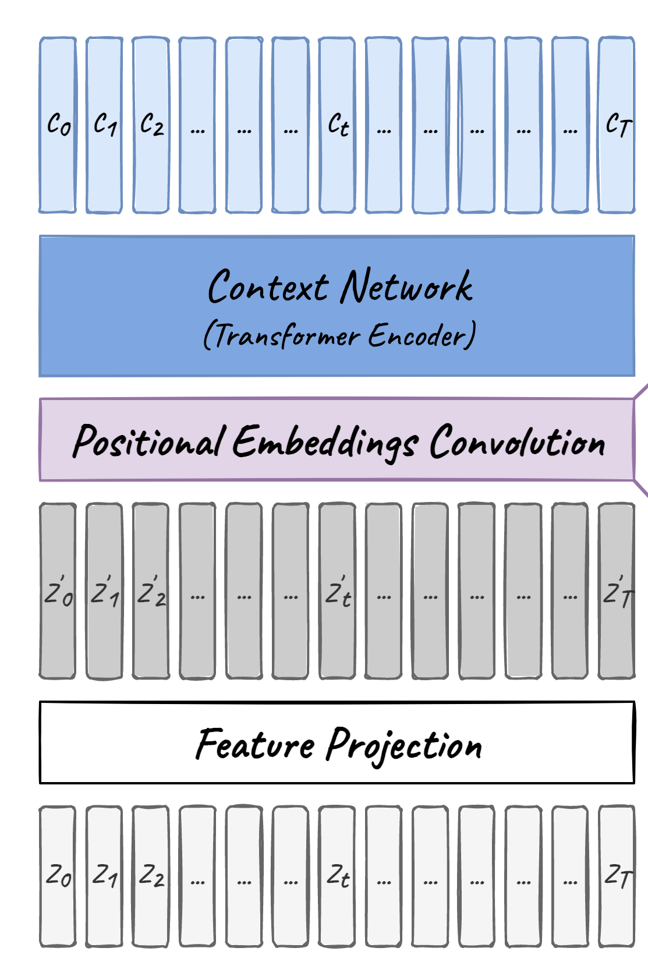
Contextualized representations
The output of the feature encoder is fed to a context network which follows the Transformer architecture
Relative positional embedding

Slide 24
Datasets
As unlabeled data, the Librispeech corpus without transcriptions containing 960 hours of audio (LS-960) or the audio data from LibriVox (LV-60k) (53.2k hours after preprocessing) is considered.
Fine-tune on five labeled data settings ( 960 hours of transcribed Librispeech), train-clean-100, train-10h, train-1h , train-10min
Fine-tune the pre-trained models for phoneme recognition on the TIMIT
It contains five hours of audio recordings with detailed phoneme labels. We use the standard train, dev and test split and follow the standard protocol of collapsing phone labels to 39 classes.

Slide 25
Pre training
The feature encoder contains seven blocks and the temporal convolutions in each block have 512 channels with strides (5,2,2,2,2,2,2) and kernel widths (10,3,3,3,3,2,2)
BASE contains 12 transformer blocks, model dimension 768, inner dimension (FFN) 3,072 and 8 attention heads. Batches are built by cropping 250k audio samples, or 15.6sec, from each example
Crops are batched together to not exceed 1.4m samples per GPU and we train on a total of 64 V100 GPUs for 1.6 days

Slide 26
Pre training
The LARGE model contains 24 transformer blocks with model dimension 1,024, inner dimension 4,096 and 16 attention heads
We crop 320K audio samples, or 20 sec, with a limit of 1.2M samples per GPU and train on 128 V100 GPUs over 2.3 days for LibriSpeech and 5.2 days for LibriVox; the total batch size is 2.7h
We use dropout 0.1 in the Transformer, at the output of the feature encoder and the input to the quantization module. Layers are dropped at a rate of 0.05 for BASE and 0.2 for LARGE [21, 12]; there is no layer drop for LV-60k

Slide 27
Fine tuning
After pre-training we fine-tune the learned representations on labeled data and add a randomly initialized output layer on top of the Transformer to predict
After Fine Tuning
Two types of Language models (LM) are considered
4-gram Model
Transformer trained on the Librispeech LM Corpus
Notes:
Transformer via bayseian Model *searching model)

Slide 28
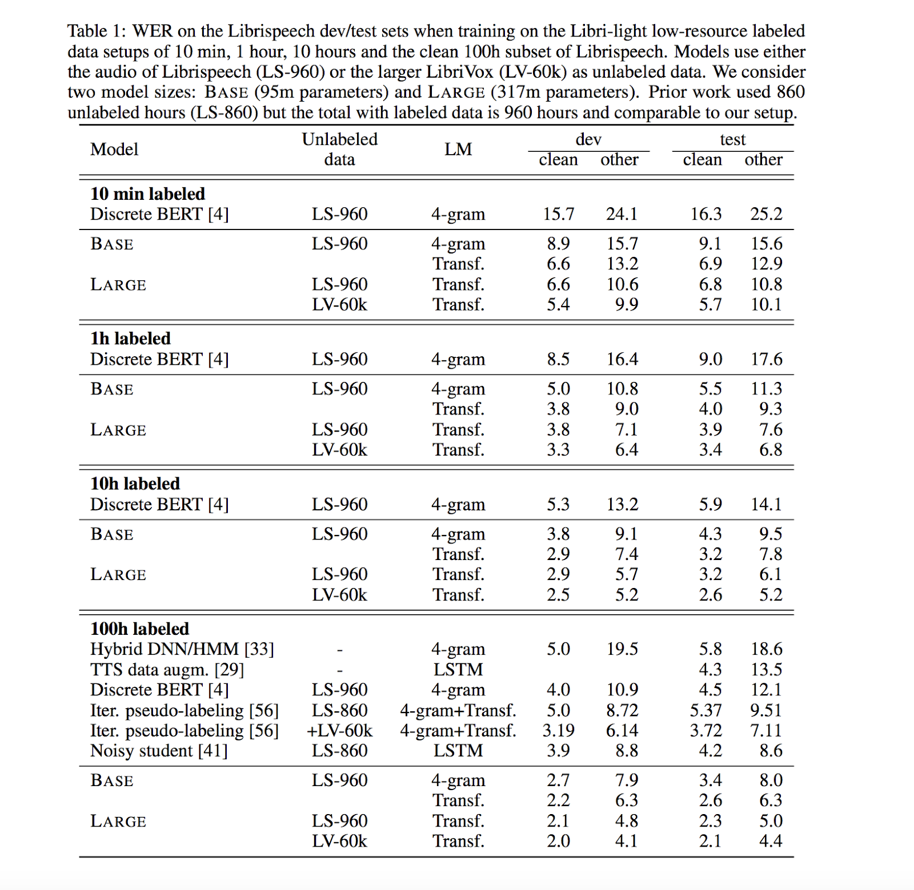
Results

Slide 29
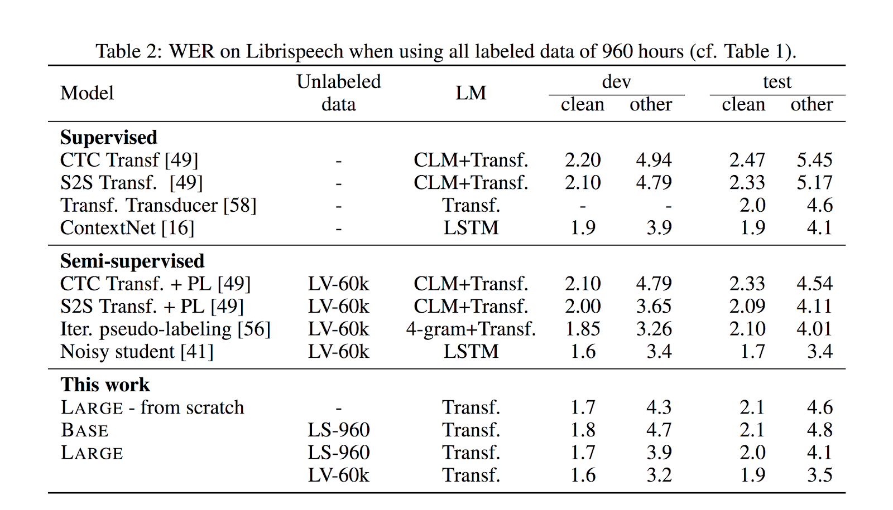

Slide 30
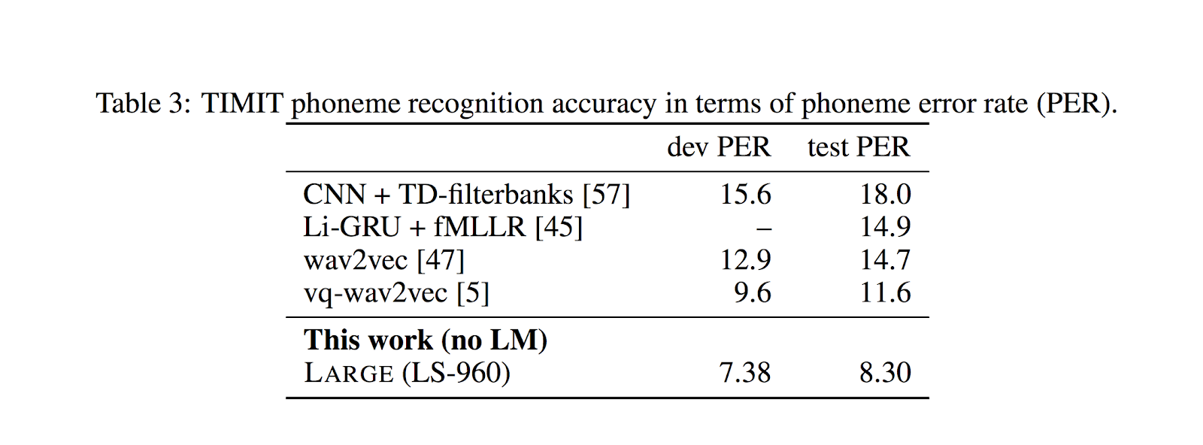

Slide 31
HuBERT: Self-Supervised Speech Representation Learning by Masked Prediction of Hidden Units by Wei-Ning Hsu, Benjamin Bolte, Yao-Hung Hubert Tsai, Kushal Lakhotia, Ruslan Salakhutdinov, Abdelrahman Mohamed
After the release wav2vec, self-supervised learning is now used more and more for speech.
BERT is based on transformer encoder HuBERT takes the next step in this regard. It is Alternative approach to learn representation units
There are 3 main problems when trying to apply BERT or other NLP models on speech data:
There are multiple sound units in each input expression
There is no lexicon of discrete sound units
Sound units have variable length and no explicit segmentation
The Authors proposed HuBERT to solve these problems

Slide 32
Motivation behind HuBert
A key ingredient of our approach is applying the prediction loss over the masked regions only, which forces the model to learn a combined acoustic and language model over the continuous inputs.
HuBERT model either matches or improves upon the state-of-the-art wav2vec 2.0 performance on the Librispeech (960h) and Libri-light (60,000h) benchmarks with 10min, 1h, 10h, 100h, and 960h fine-tuning subsets.
Using a 1B parameter model, HuBERT shows up to 19% and 13% relative WER reduction on the more challenging dev-other and test-other evaluation subsets.
Notes:
The main idea of this paper is discretization of the audio inputs through hidden units

Slide 33
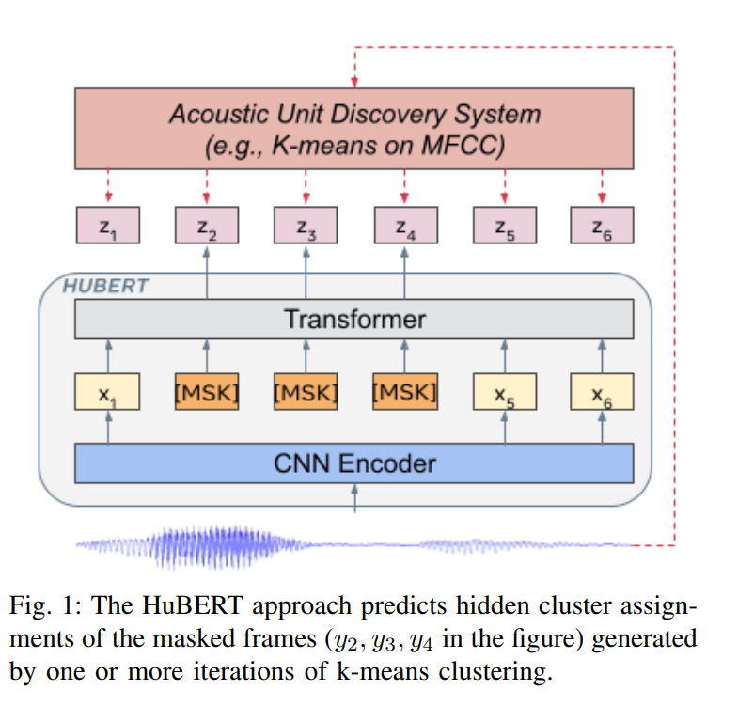
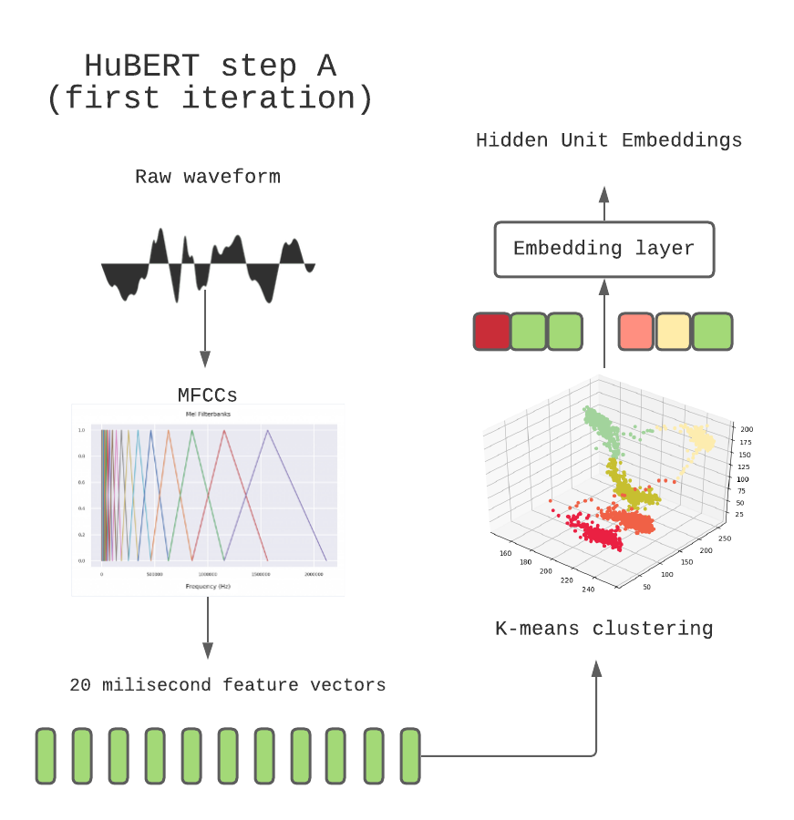
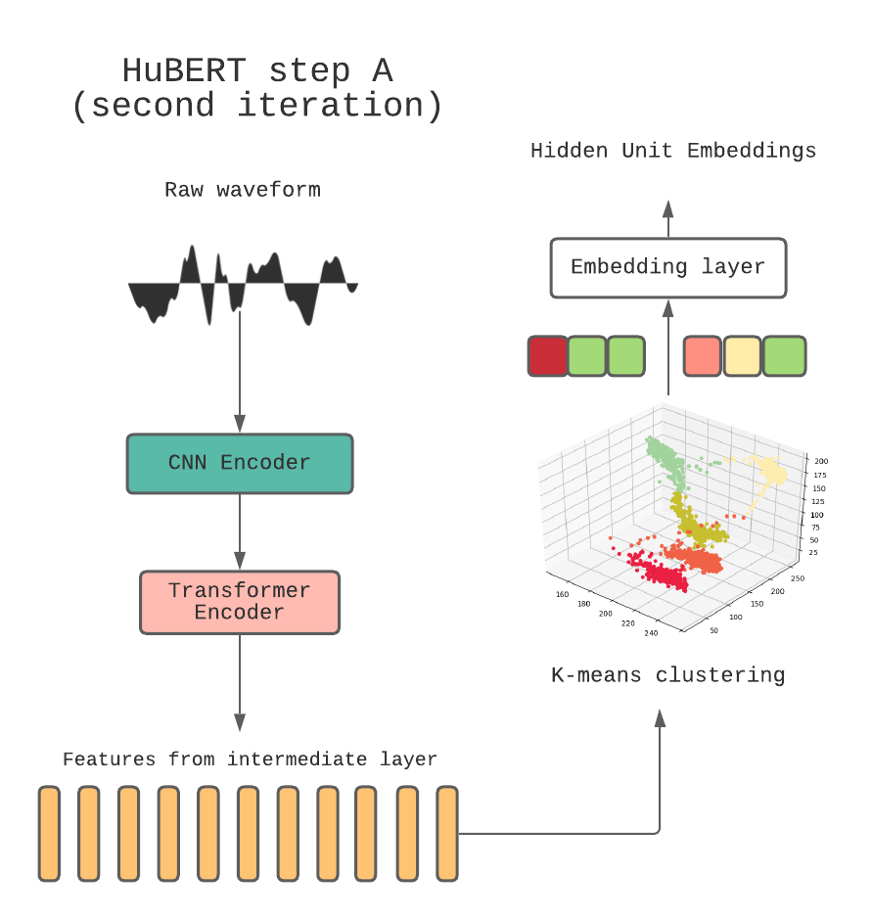
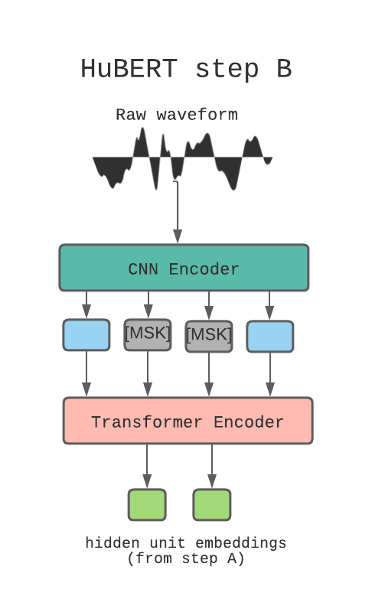
Architecture
Notes:
The CNN is responsible for generating features from the raw audio
Prediction loss on masked regions only
the cross-entropy loss is then used on the logits to penalize wrong predictions.

Slide 34
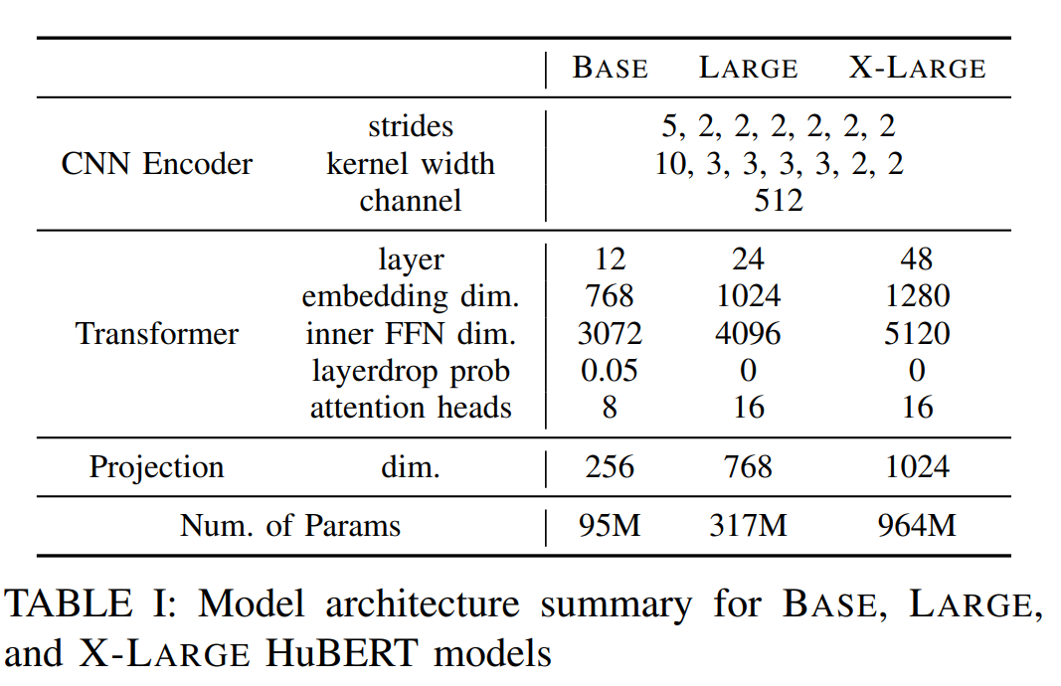

Slide 35
Dataset
For unsupervised pre-training, full 960 hours of LibriSpeech audio or 60,000 hours of Libri-light audio, derived from the LibriVox.
For supervised fine-tuning, five different partitions are considered:
Libri-light 10-minute, 1-hour, 10- hour splits and LibriSpeech 100-hour (train-clean-100) and 960-hour (train-clean-100, train-clean-360, train-other-500 combined) splits.
Notes:
LibriVox project that contains English recordings of copyright-free audiobooks

Slide 36
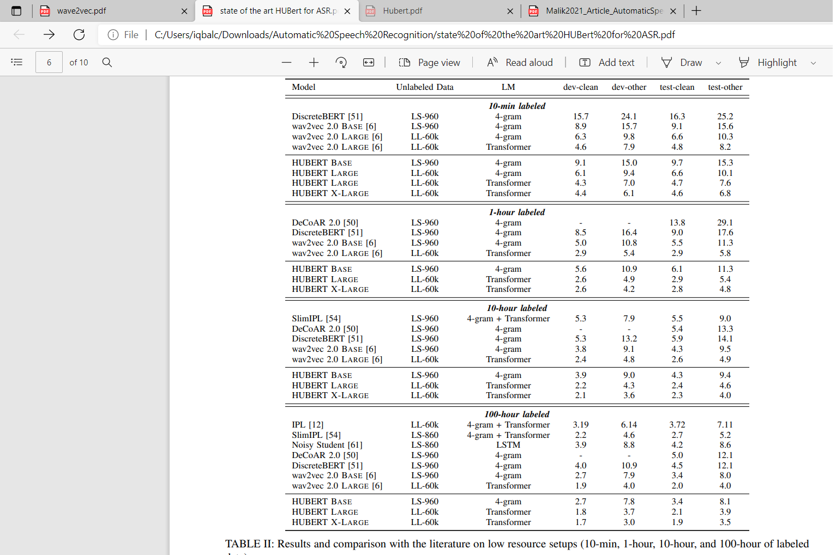

Slide 37
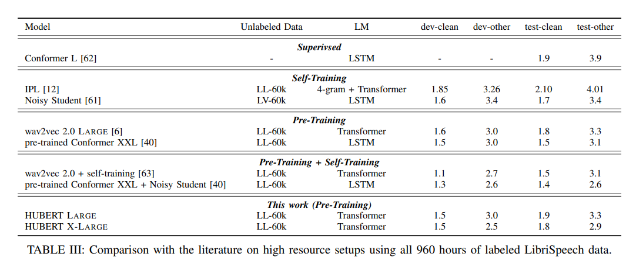

Slide 38
HuBERT vs. wav2vec 2.0
HuBERT uses the cross-entropy loss, makes training easier and more
HuBERT builds targets via a separate clustering process
HuBERT re-uses embeddings from the BERT encoder to improve targets,
Wav2vec use complex combination of contrastive loss + diversity loss used by wav2vec 2.0
wav2vec 2.0 learns its targets simultaneously while training
wav2vec 2.0 only uses the output of the convolutional network for quantization (via a quantization process)
In terms of model architecture, the BASE and LARGE versions of HuBERT have the same configuration as the BASE and LARGE versions of wav2vec 2.0 (95 million and 317 million of parameters respectively). However,
an X-LARGE version of HuBERT is also used with twice as many transformer layers as in the LARGE version, with almost 1 billion parameters.
Notes:
A, HuBERT looks very similar to wav2vec 2.0:
both models use the same convolutional network, transformer encoder.
training processes are very different,
and HuBERT’s performance matches or improves upon wav2vec 2.0

Slide 39
HuBERT-EE: Early Exiting HuBERT for Efficient Speech Recognition
Ji Won Yoon , Beom Jun Woo , and Nam Soo Kim

Slide 40
Motivation
Pre-training with self-supervised models, such as Hidden-unit BERT (HuBERT) and wav2vec 2.0, has brought significant improvements in automatic speech recognition (ASR)
Challenges:
Expensive computational cost to achieve outstanding performance
Slowing down the inference speed
HuBERT-EE allows the model to stop the inference dynamically
In HuBERT-EE, multiple early exit branches are added at the intermediate layers
Each branch is used to decide whether a prediction can be exited early
Experimental results on the LibriSpeech dataset show that HuBERT-EE can accelerate the inference of a large-scale HuBERT model

Slide 41
Motivation
Hidden-unit BERT (HuBERT) is one of the most prominent models for speech recognition.
On the LibriSpeech benchmark, fine-tuned HuBERT using connectionist temporal classification (CTC) achieves the state-of-the-art word error rate (WER) results.
Large-scale pre-trained models usually suffer from slow inference speed, which may hinder their usage in real-world applications where fast inference is desirable.
The proposed HuBERT-EE accelerates the inference procedure by adding multiple early exit branches at the intermediate layers of the HuBERT. When the intermediate prediction of the early exit branch is confident, the model stops the inference, and the result is returned early.
Experimental results on the LibriSpeech dataset, it is verified that the HuBERT-EE can effectively perform early exiting for speech recognition. It accelerates the inference of the large-scale HuBERT with minimal performance loss.
Notes:
Early Exiting is a technique to adaptively accelerate the inference speed by returning the result at an intermediate layer

Slide 42
Model Architecture
HuBERT-EE mainly consists of a backbone network and multiple early exit branches.
The backbone is built upon a 24-layers Transformer encoder with an additional linear projection layer.
The early exit branches are located at some intermediate layers of the backbone network to enable early predictions.

Slide 43
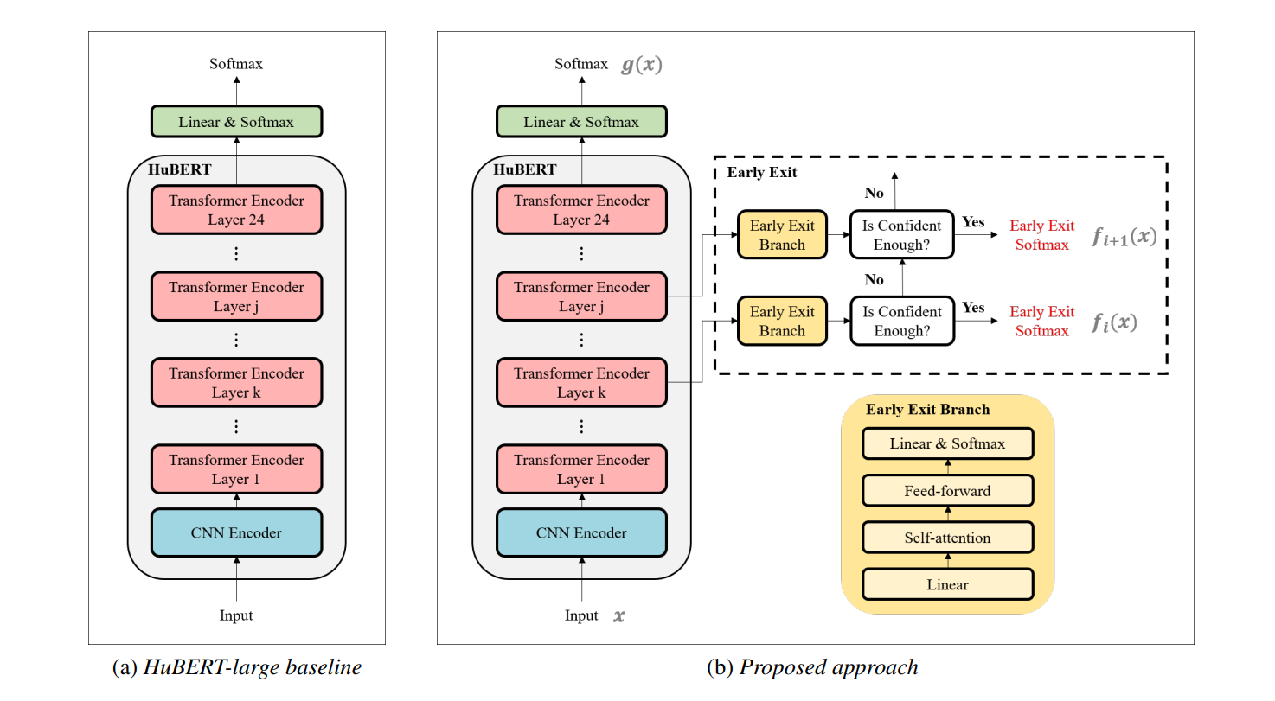
Notes:
the proposed approach can stop the inference dynamically.
Multiple early exit branches are attached at the intermediate layers to make early exit decisions.
When the early exit branch is confident enough in its prediction, the corresponding result can be exited early

Slide 44
Training
The training of HuBERT-EE is similar to that of the original HuBERT.
The main difference is that we modify the fine-tuning process of the HuBERT model to enable early exit decisions at the inference time.
The training includes three steps:
The first step is pre-training the HuBERT backbone model from scratch,
The second is fine-tuning the backbone model with the linear projection layer,
The third is fine-tuning the early exit branches.

Slide 45
Fine tuning
After pre-training the backbone, we add a randomly initialized linear projection layer on top of the Transformer to predict characters. Then, we use CTC loss for ASR fine-tuning of the whole model weights except for the early exit branches.
This stage is identical to the HuBERT fine-tuning

Slide 46
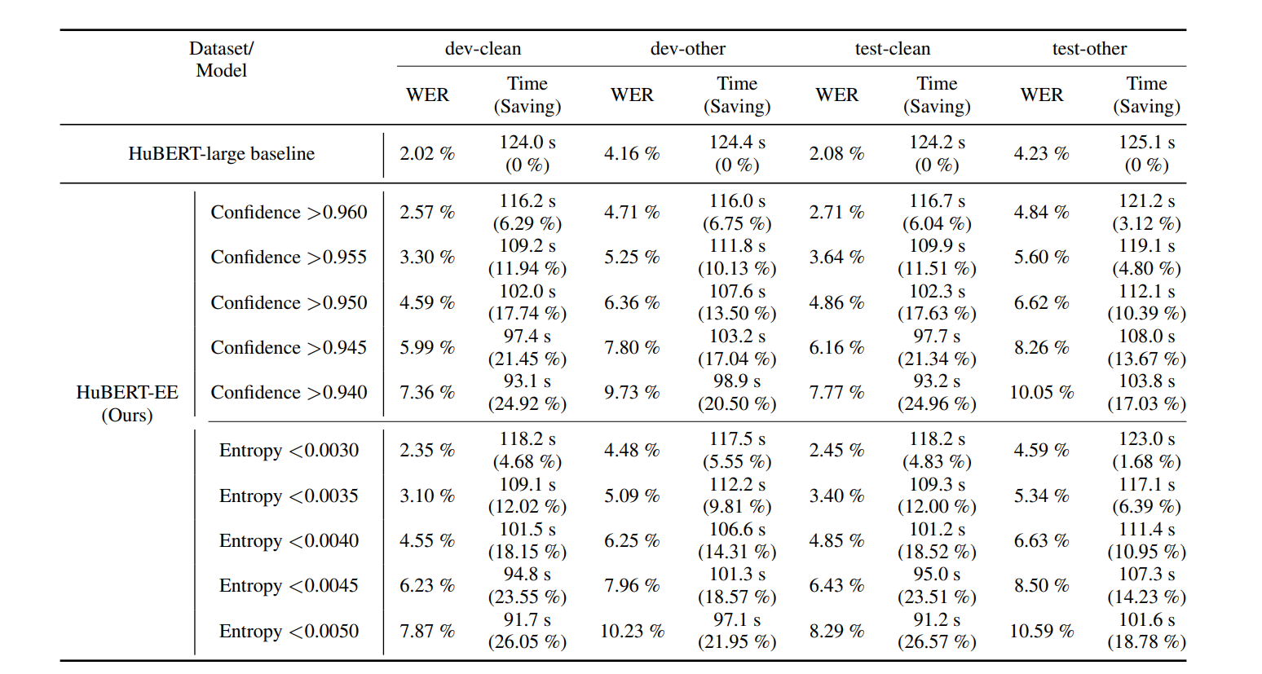
Comparison
Notes:
The maximum probability is a straightforward measurement of certainty is confidence
Entropy is a well-known measure of uncertainty…
the prediction with lower entropy might be more confident to exit.

Slide 47
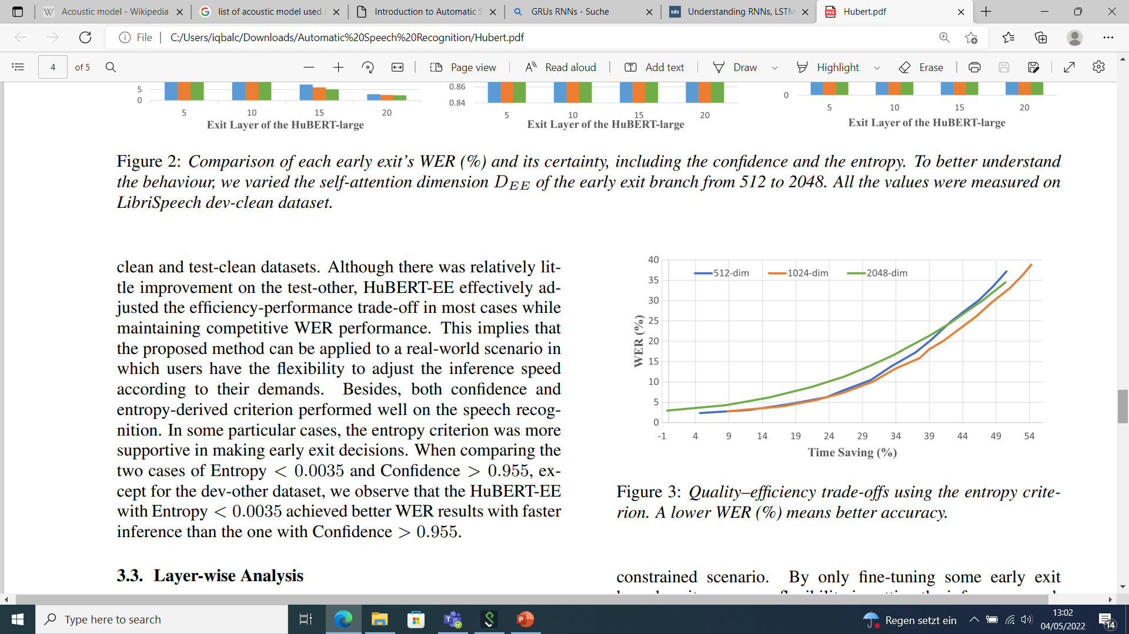
Lower WER means better accuracy
From the experimental results on the LibriSpeech,
It is verified that the HuBERT-EE was successfully applied to the ASR task while achieving a good quality–efficiency trade-off.
From a practical perspective, HuBERT-EE represents a significant step toward efficient speech recognition.

Slide 48
Pushing the Limits of Semi-Supervised Learning for Automatic Speech Recognition
Yu Zhang∗ James Qin∗ Daniel S. Park∗ Wei Han Chung-Cheng Chiu Ruoming Pang Quoc V. Le Yonghui Wu

Slide 49
Motivation
Combined recent advancements to improve the performance of ASR
Architecture: Conformer
Pre-training: Wave2vec 2.0
Self training : Noisy Student Training with SpecAugment
A self-supervised learning based on advancement for RNN-T
LibriSpeech test/test-other sets against the current state-of-the-art WERs 1.7%/3.3%.-> 1.4%/2.6%
Notes:
An RNN-T processes a sequence of inputs in order, so that the output corresponding to each input factors in both the inputs and outputs that preceded it.

Slide 50
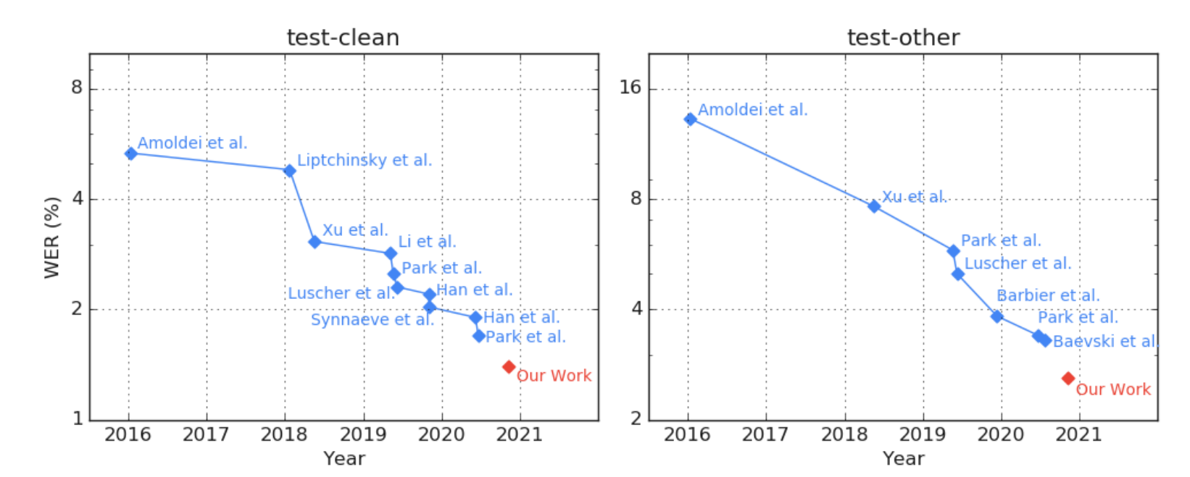
Combined SSL using Conformers, they obtained state-of-the-art performance on the LibriSpeech dev and test sets, achieving the word-error-rates 1.3%/2.6%/1.4%/2.6%
History of state-of-the-art LibriSpeech test/test-other WERs (%) according to Papers With Code

Slide 51
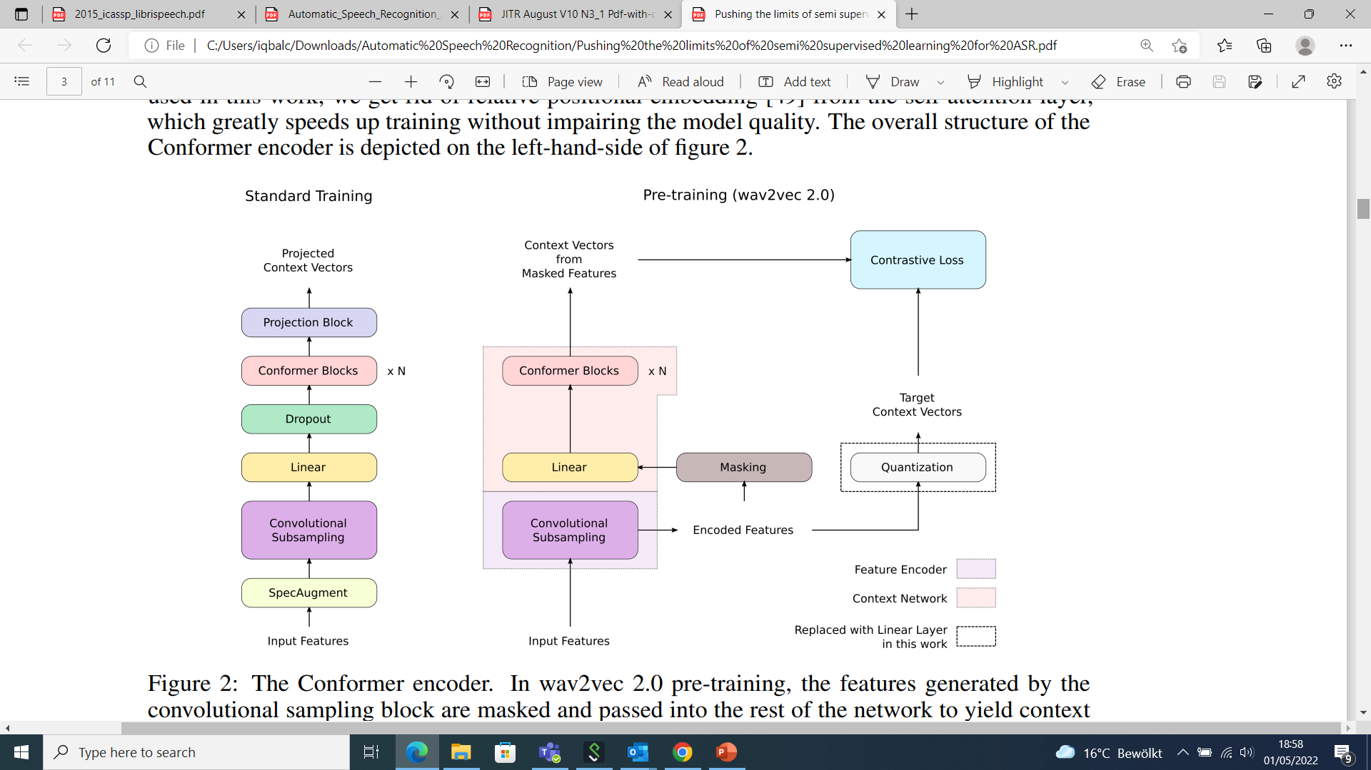
Architecture
Conformer
( Convolution-Augmented Transformer)
[Gulai et at., 2020]
Notes:
Get rid of all the relative positional embedding and attention layers
For speed up the training of larger model
But for small models all these embedings are important

Slide 52
Mel-features instead waveform features
Used RNN-T instead CTC
4 time reduction on features to enhance the computation
Removes quantization and diversity loss

Slide 53
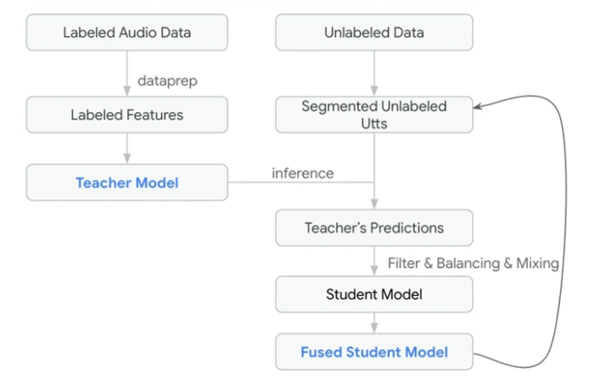
Self Training or Fine Tuning
Noisy Student Training with SpecAugment
Firstly train a teacher model from the labelled data
And use that model to label the unlablled data after filtering and balancing,
And then used to train the next generation Student model
After that this model is fused to unlablled data

Slide 54
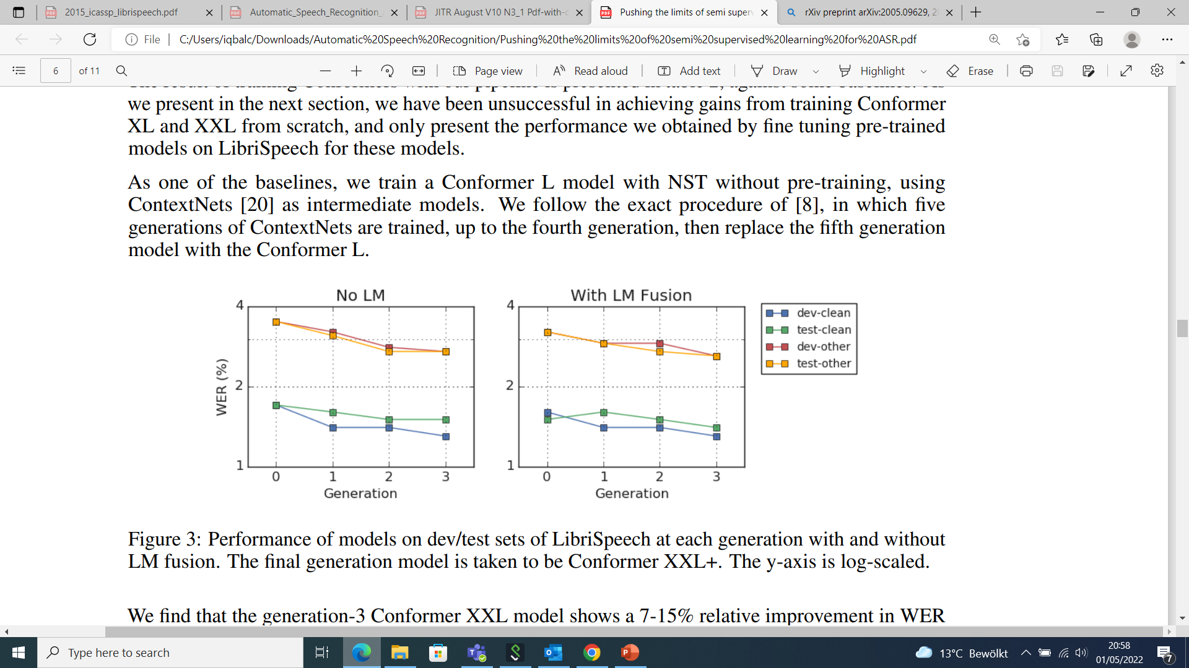
Performance of models on dev/test sets of LibriSpeech at each generation with and without LM fusion
7-15% relative improvement in WER across the dev and test sets compared to the pre-trained baseline.

Slide 55
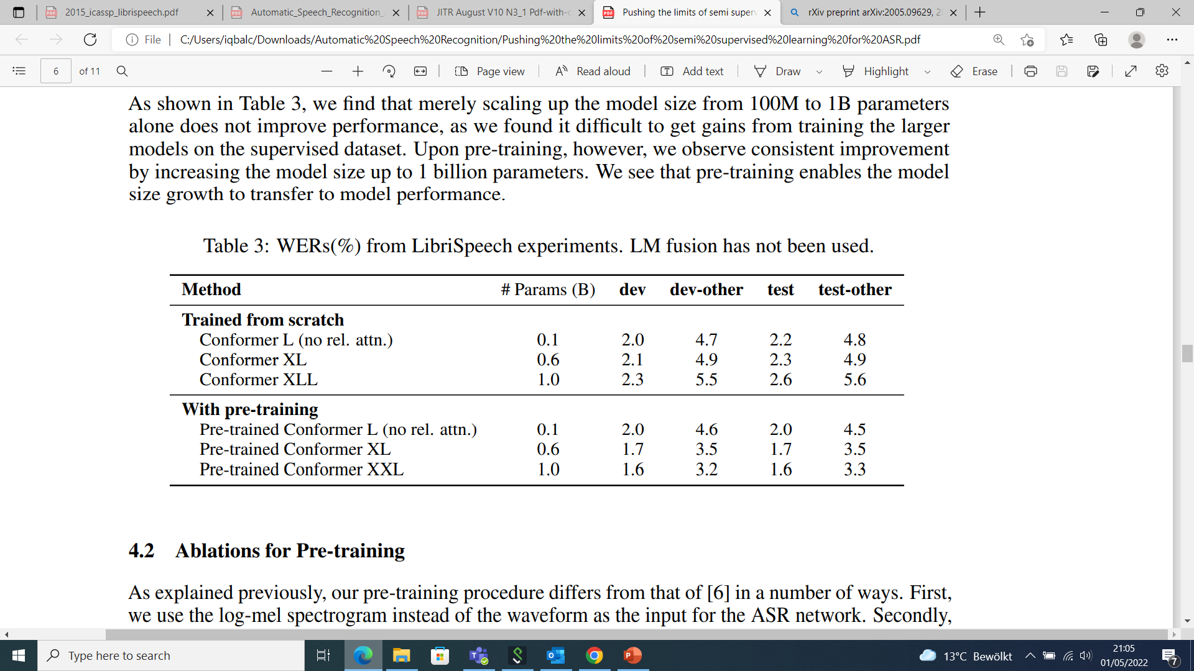
Model Size and Pre-training
Pre-training enables the model size growth to enhance the performance

Slide 56
Summary
Noisy student Training with SpecAugmented and wave2vec 2.0 pretraining are complementary
Self Supervised Learning is benefit for larger models
Larger model simplify the training process
E.g data processing, architecture, quantization and diversity loss

